Slide 1
POS Tagging y NER
Diplomado de especialización de
desarrollo de aplicaciones con Inteligencia Artificial

Slide 2
Colaboradores:
Erasmo Gomez
Gina Bustamante

Slide 3
POS (Part of Speech)
8 traditional parts of speech for IndoEuropean languages
Noun, verb, adjective, preposition, adverb, article, interjection, pronoun, conjunction, etc.
Around for over 2000 years (Dionysius Thrax of Alexandria, c. 100 B.C.)
Called: parts-of-speech, lexical category, word classes, morphological classes, lexical tags, POS

Slide 4
POS (Part of Speech)
8 traditional parts of speech for IndoEuropean languages
Noun, verb, adjective, preposition, adverb, article, interjection, pronoun, conjunction, etc.
Around for over 2000 years (Dionysius Thrax of Alexandria, c. 100 B.C.)
Called: parts-of-speech, lexical category, word classes, morphological classes, lexical tags, POS

Slide 5
POS (Part of Speech)
N noun chair, bandwidth, pacing
V verb study, debate, munch
ADJ adj purple, tall, ridiculous
ADV adverb unfortunately, slowly
P preposition of, by, to
PRO pronoun I, me, mine
DET determiner the, a, that, those
CONJ conjunction and, or

Slide 6
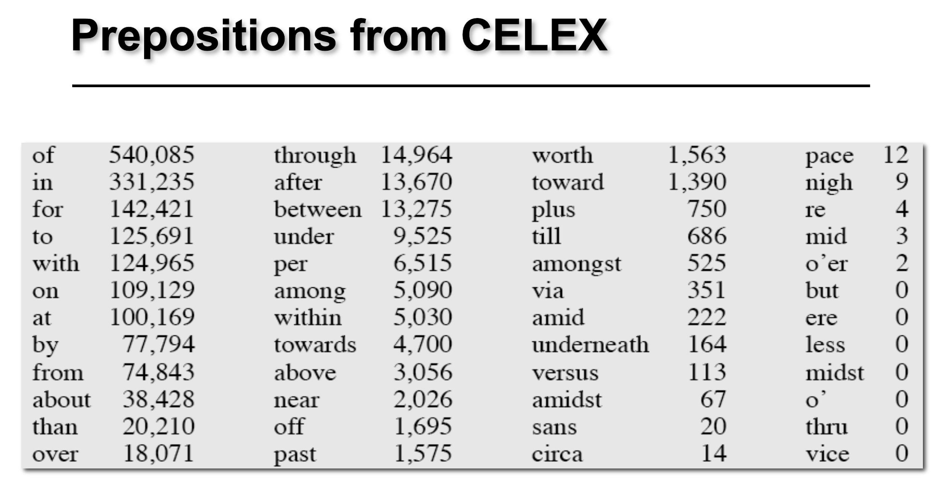

Slide 7
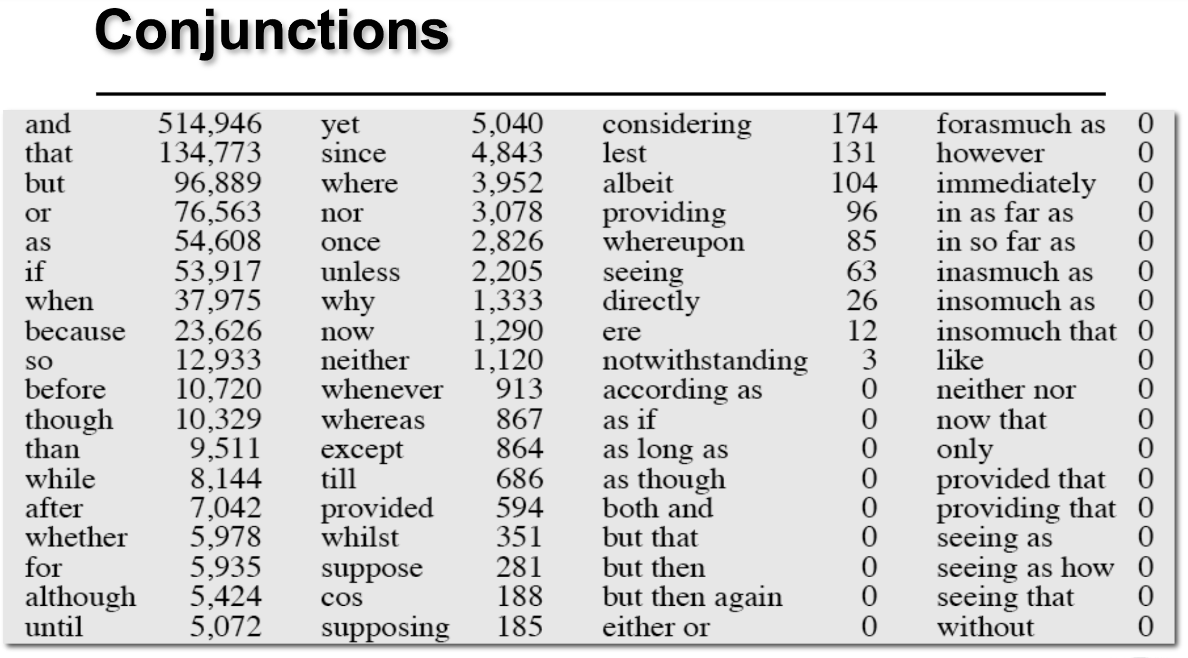

Slide 8
POS - Choosing a Tagset
There are so many parts of speech, potential distinctions we can draw
To do POS tagging, we need to choose a standard set of tags to work with
More commonly used set is finer grained, the “Penn TreeBank tagset”, 45 tags PRP$, WRB, WP$, VBG
Even more fine-grained tagsets exist

Slide 9
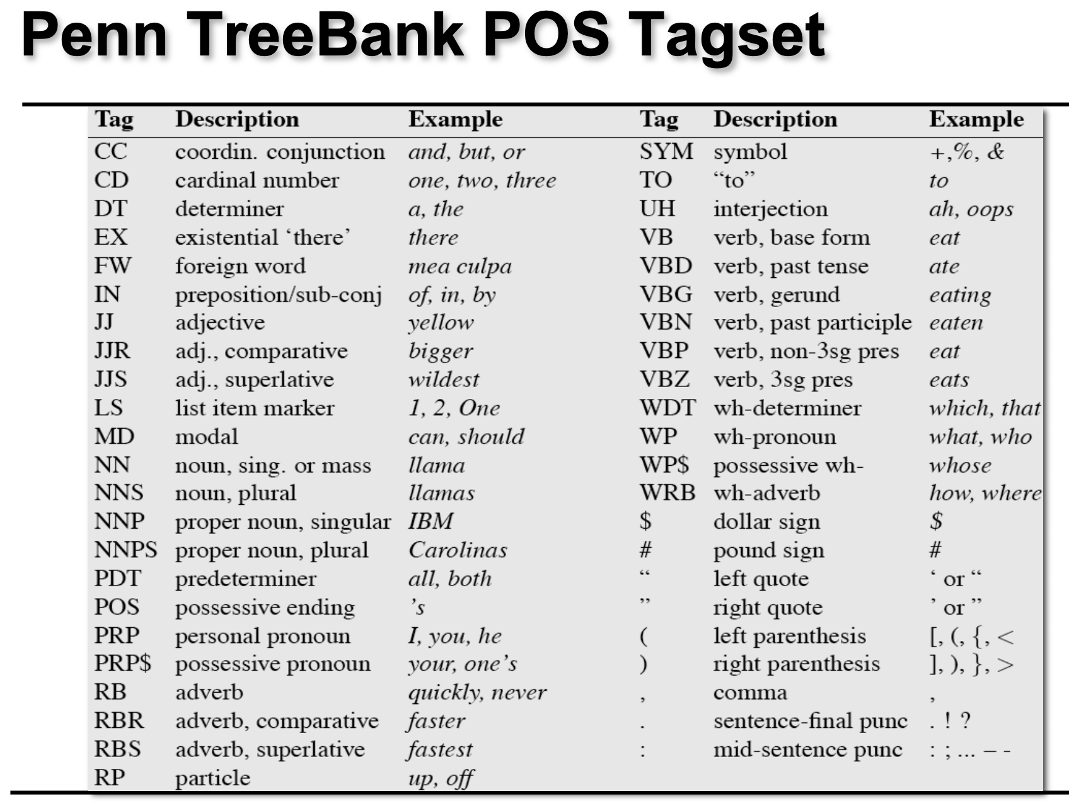

Slide 10
POS - Using the Tagset
The/DT grand/JJ jury/NN commmented/VBD on/IN a/DT number/NN of/IN other/JJ topics/NNS ./.

Slide 11
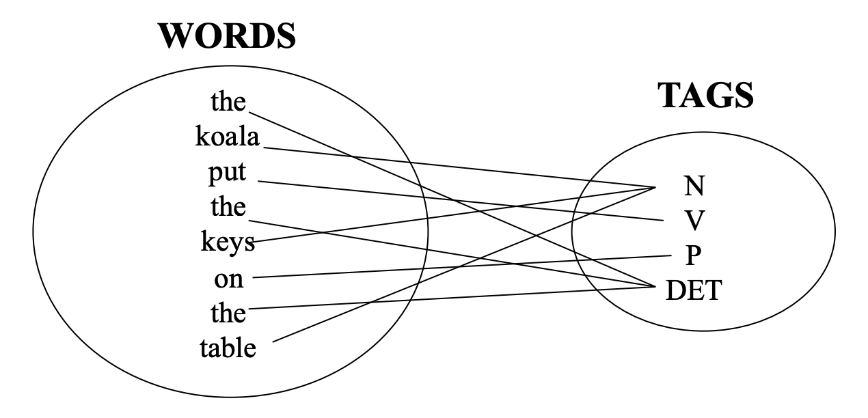
POS Tagging definition
The process of assigning a part-of-speech or lexical class marker to each word in a corpus:

Slide 12
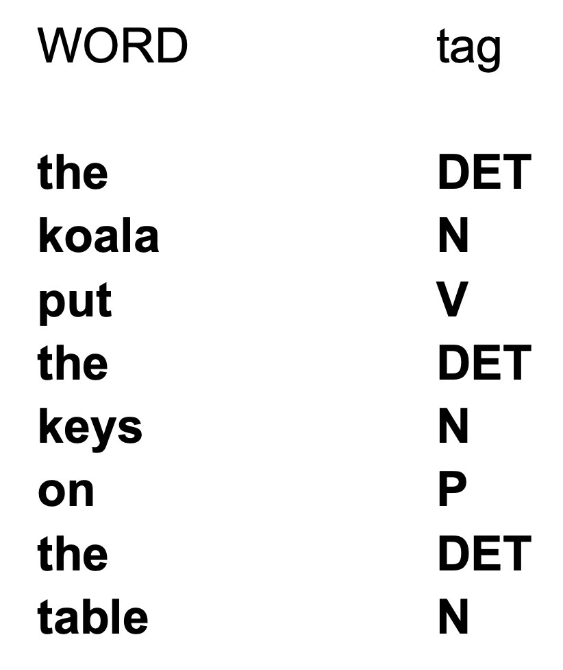
POS Tagging example

Slide 13
POS tagging problems
Words often have more than one POS: back
The back door = JJ
On my back = NN
Win the voters back = RB
Promised to back the bill = VB
The POS tagging problem is to determine the POS tag for a particular instance of a word.

Slide 14
Sequence Labeling as Classification
Classify each token independently but use as input features, information about the surrounding tokens (sliding window).
John saw the saw and decided to take it to the table.

Slide 15
NER (Named Entity Recognition)
NE involves identification of proper names in texts, and classification into a set of predefined categories of interest.
Three universally accepted categories: person, location and organisation.
Other common tasks: recognition of date/time, expressions, measures (percent, money, weight etc), email addresses etc.
Other domain-specific entities: names of drugs, medical conditions, names of ships, bibliographic references etc.

Slide 16
NER problems
Category definitions are intuitively quite clear, but there are many grey areas.
Many of these grey area are caused by metonymy.
Organisation vs. Location : “England won the World Cup” vs. “The World Cup took place in England”.
Company vs. Artefact: “shares in MTV” vs. “watching MTV”
Location vs. Organisation: “she met him at Heathrow” vs. “the Heathrow authorities”

Slide 17
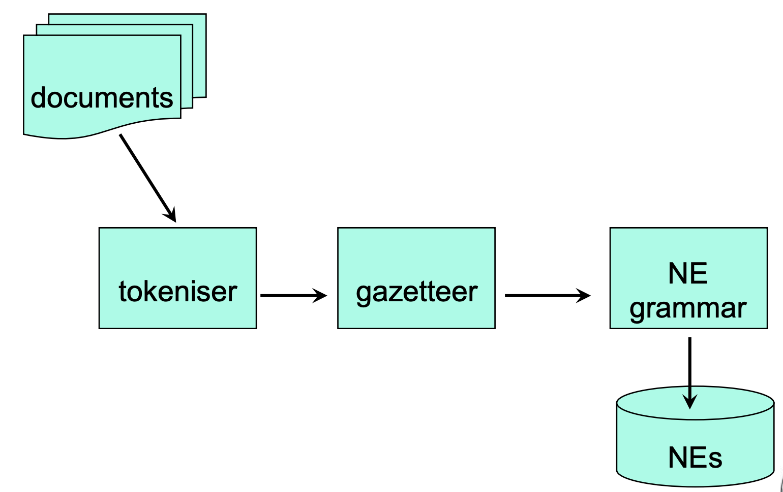
NER System Architecture

Slide 18
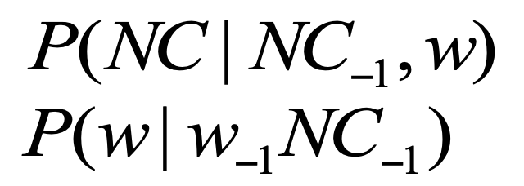
Name Entity Recognition
IndentiFinder (Bikel et al, 1999)
Given a set of Named Entities (NE)
PERSON, ORGANIZATION, LOCATION, MONEY, DATE, TIME, PERCENT
Predict NEs of a sentence with Hidden Markov models

Slide 19
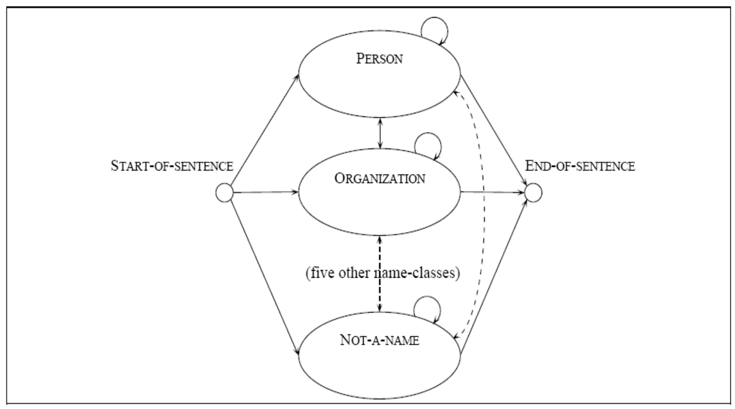

Slide 20
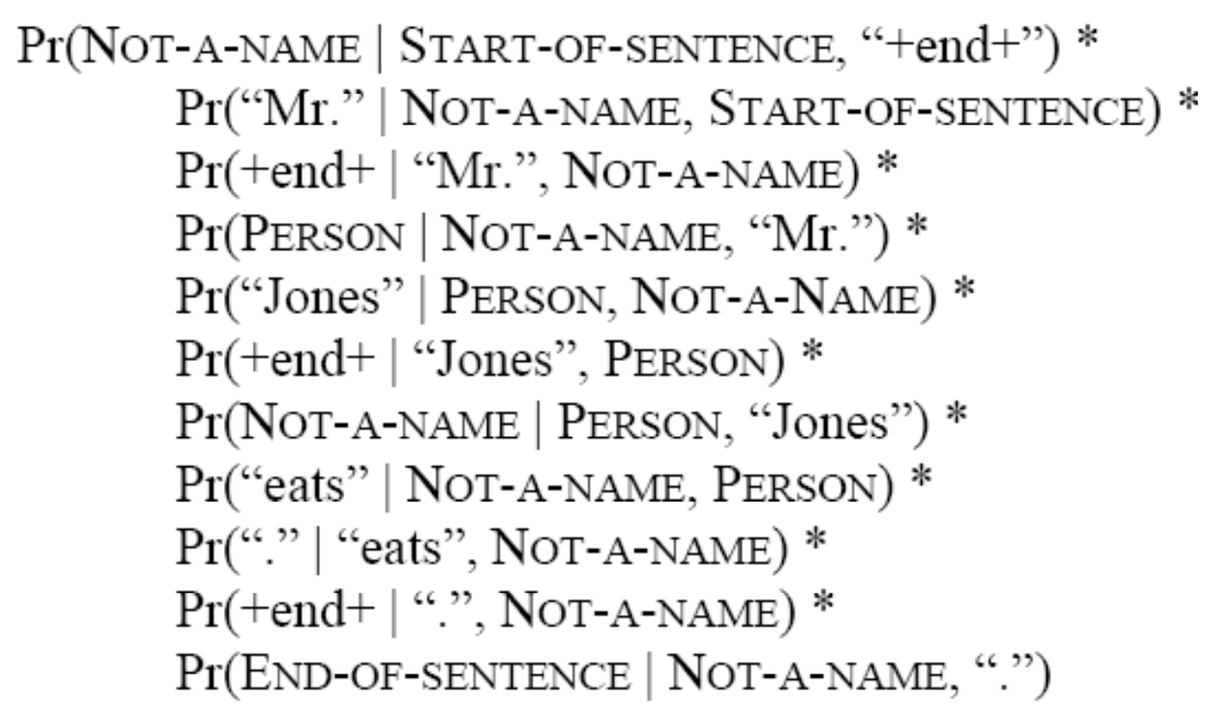
Probability of “Mr. John eats.”

Slide 21
Applications of NER
Yellow pages with local search capabilities.
Monitoring trends and sentiment in textual social media.
Interactions between genes and cells in biology and genetics.

Slide 22
Pasemos a la parte práctica ...

